Slide 1
Proposal for HOOF Information System
Specter Designs

Slide 2
Specter Designs Introduction
Who we are
Our Background
Our Vision

Slide 3
Agenda
Problem Areas
Problem Areas Improvement
Benefits of Our Improvements
Use Case Overview
Example Use Case
Use Case Diagram
To-Be Model Prototypes

Slide 4
Potential Problem Areas
Lack of an online presence, limiting company awareness
Lack of online donation options for users, limiting the ways they can give.
Lack of central information source, increasing information gathering time

Slide 5
Problem Areas Improvement
We want to create a centralized database where all the company data may be stored and accessed
We Believe we can improve donation revenue through expanding online options.
We see ways to facilitate improvement in the grant writing process

Slide 6
Benefits of Our Improvements
By conservative estimates, we expect to grow HOOF individual Donations by 20%, about $550 through increased engagement and online donation options
We expect to increase Grants by a conservative estimate of 20%, about $3,600 by halving the time to write grants.
Proper Social Medial outreach might bring in another 10% conservative growth in individual donations, about $225

Slide 7
Use Cases Overview
To document identified system requirements, a technique called use cases was incorporated into the design
For these system requirements, we have also outlined a large number of use cases, also contained in the full report.
These cases outline situations the user might encounter and how our system will give the user capability in those situations.
On the next slide are examples of interactions we have prioritized fulfilling

Slide 8
High Focus Use Case Examples
Use | Risk | Reasoning
Writing Grants Primary Actors: HOOF Board Members | High | Grant serve as a large potential revenue for HOOF
Organizing Events Primary Actors: HOOF Board Members | High | Events also serve to bring in revenue for HOOF
Make Online Donation Primary Actors: Donors | High | Donations again are a source of revenue that can hurt the organization if lost
Register Auction Item Primary Actors: Donors | High | Following Donations, these are important for revenue growth and therefore high risk if lost

Slide 9
To-Be Model Prototype
We have designed models for key HOOF Web functions
These represent areas of high risk and importance to operations and donation income
On the next slides are models of these areas

Slide 10
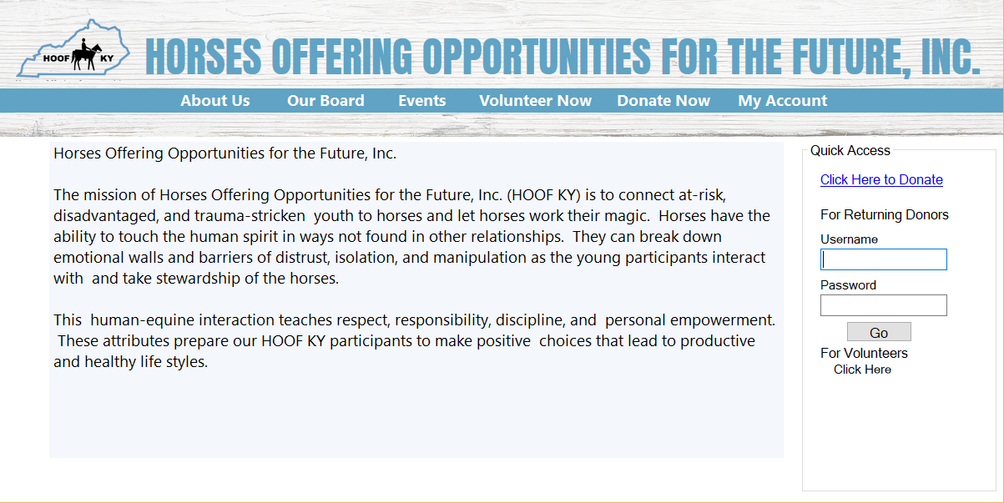
HOOF Front Page

Slide 11
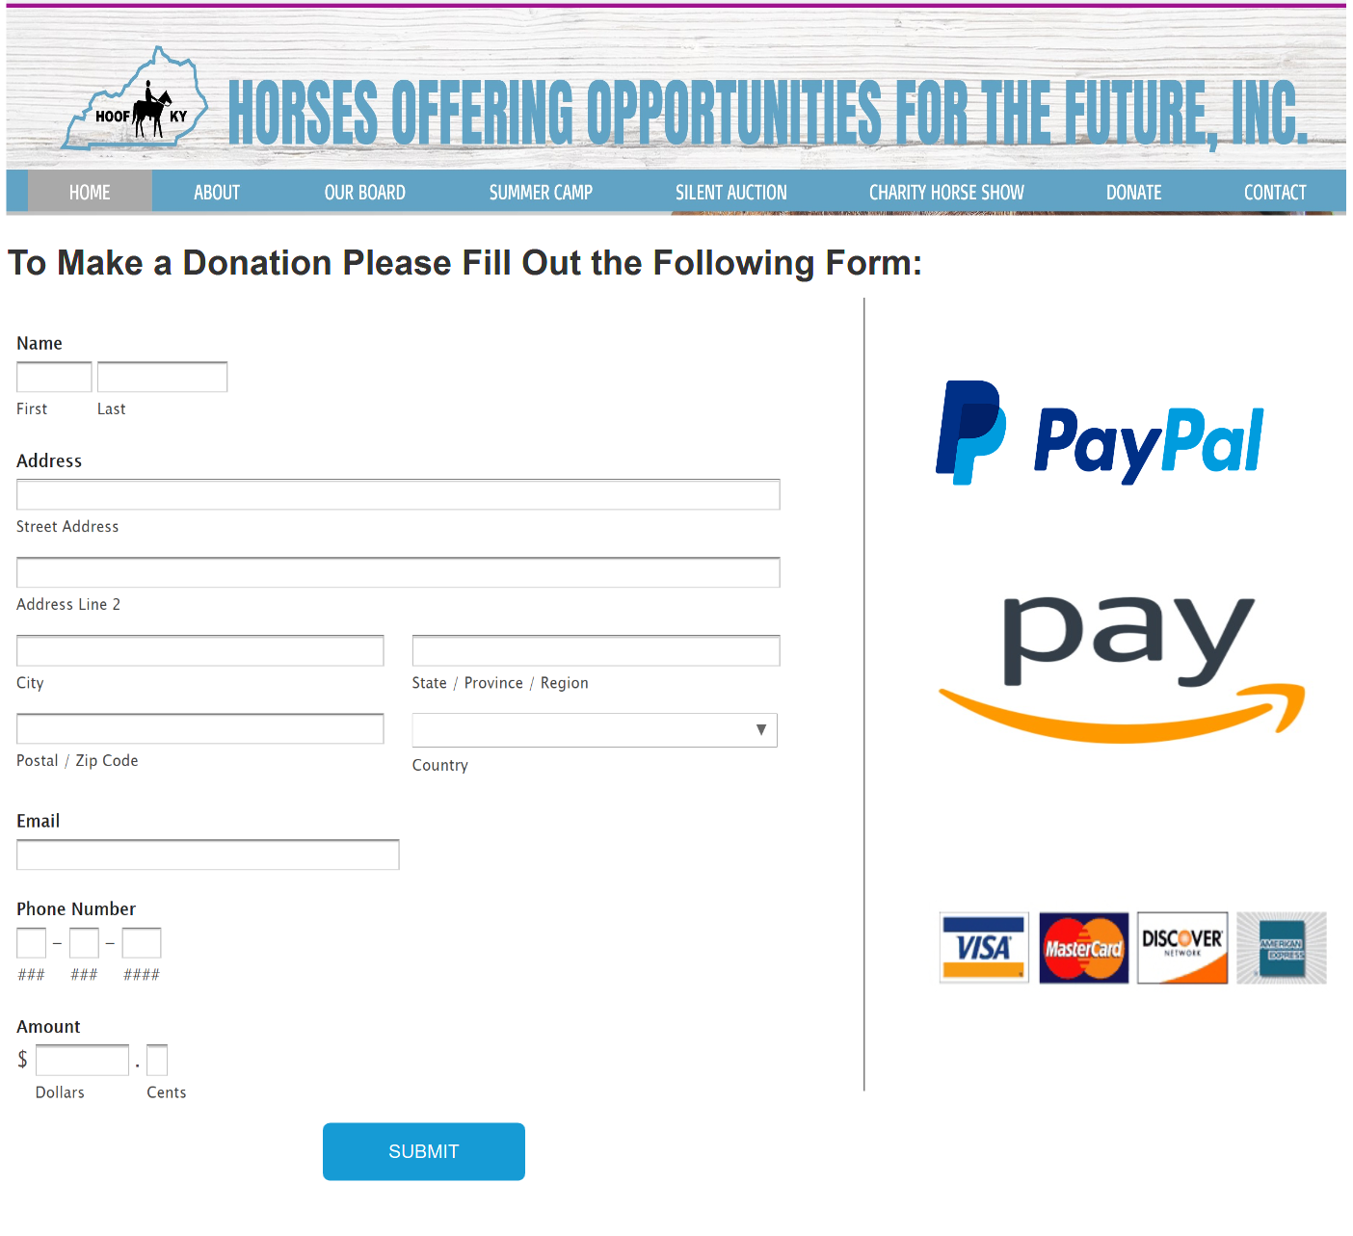
Make Online Donation

Slide 12
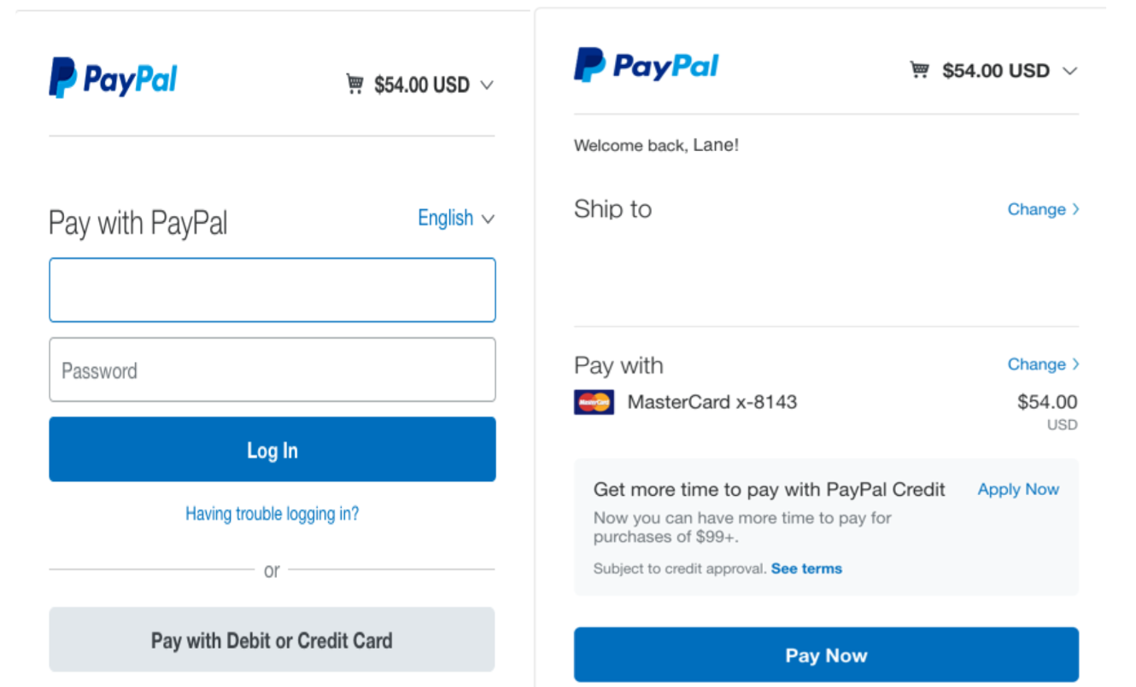
Third Party Check Out Screen

Slide 13
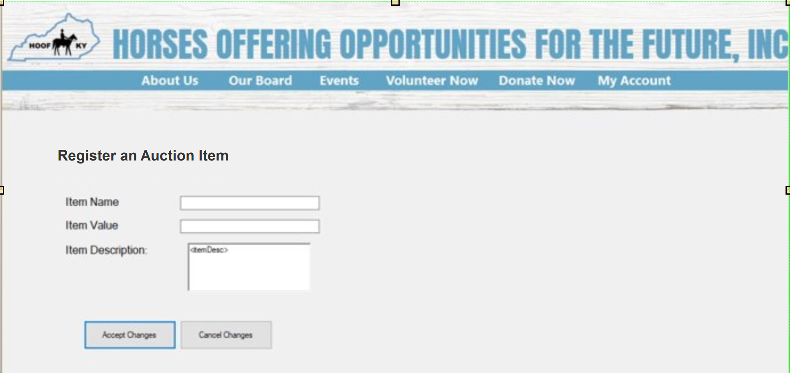
Registering an Auction Item

Slide 14
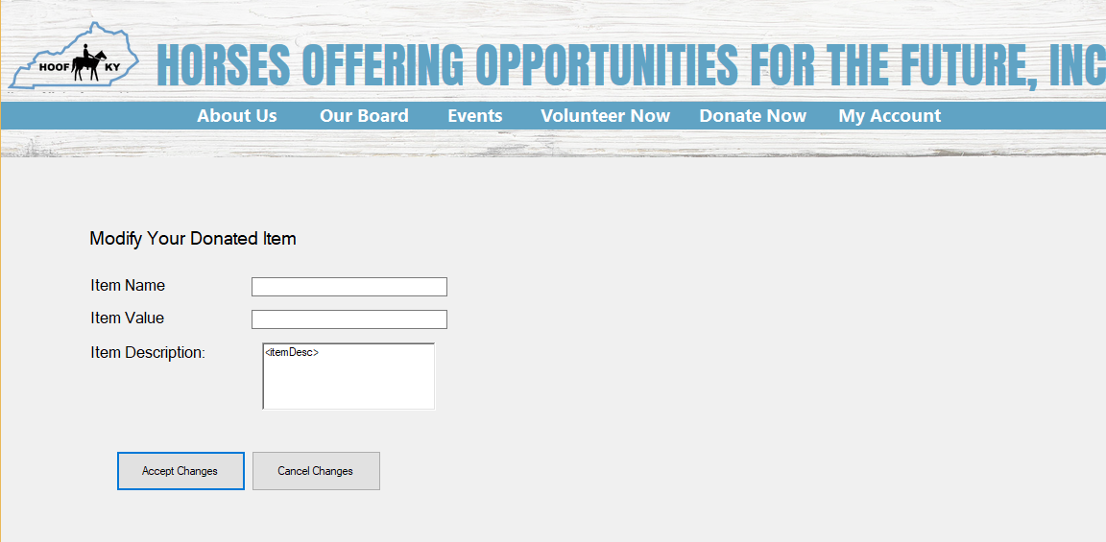
Modify Auction Item

Slide 15
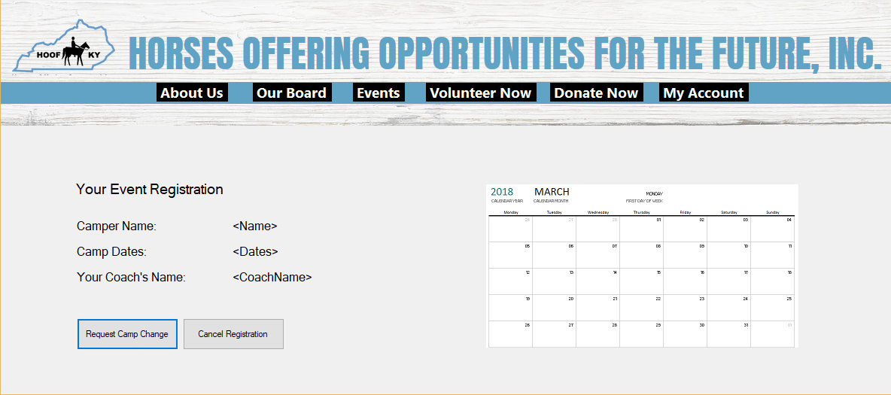
Delete Camp Registration

Slide 16
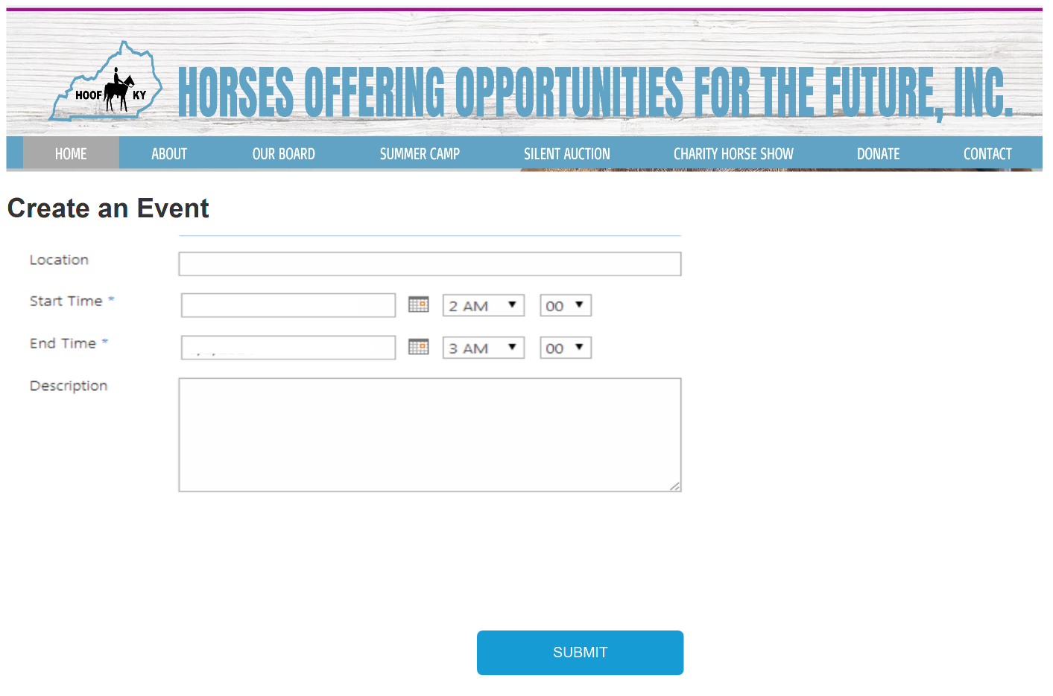
Event Management

Slide 17
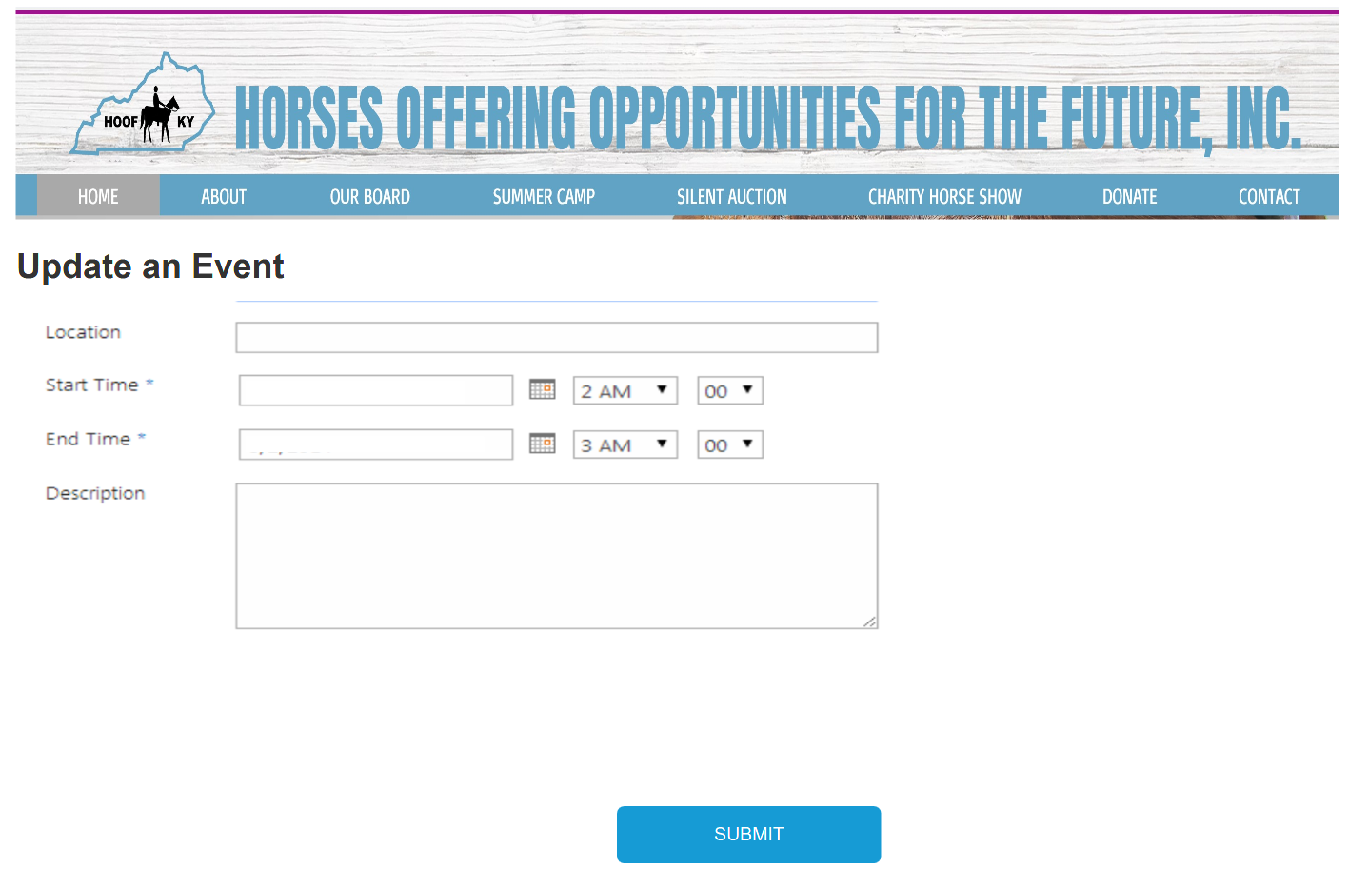
Event Management

Slide 18
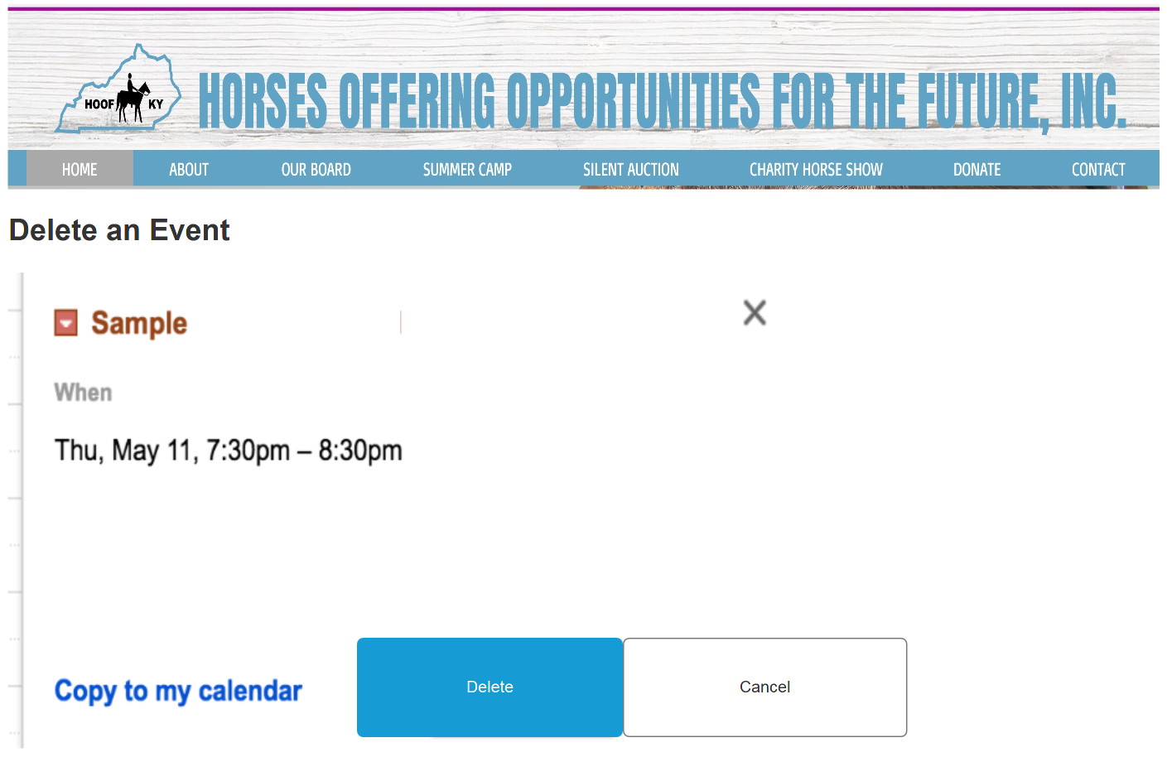
Event Management

Slide 19
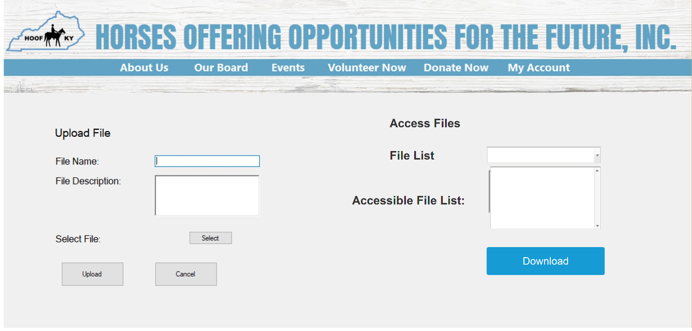
Grants Portal

Slide 20
Conclusion
The system we propose will increase HOOF's donation revenue and grants totaling to $4,375 per year additional revenues.
Our analysis gives a 56% Return on Investment for HOOF, and the project should break even after 3.29 years.
Any Questions?

